Slide 1



Industrial automation
Michiel Hamblok
Dennis Merken
Jason Vaesen
Bart Grispen
Abad Sethi

Slide 2
Inhoudsopgave
PLC
Sigfox
Database/NodeRed
2

Slide 3
PLC
,,,
,,,
,,,
3
,,, - ,,, - ,,, - ,,,

Slide 4
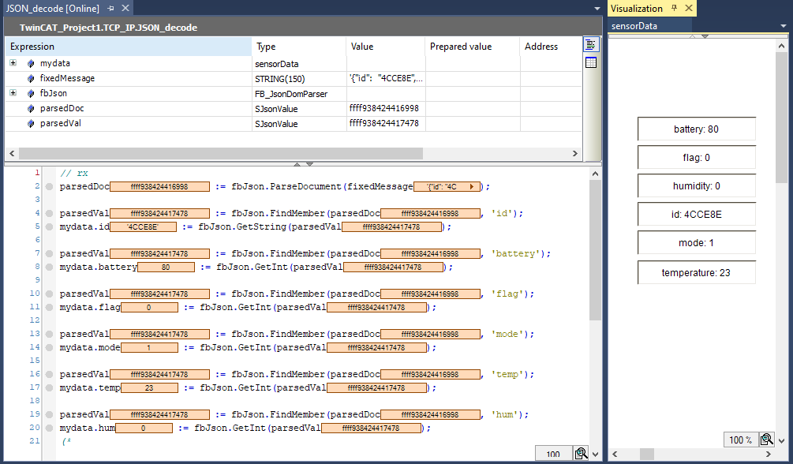
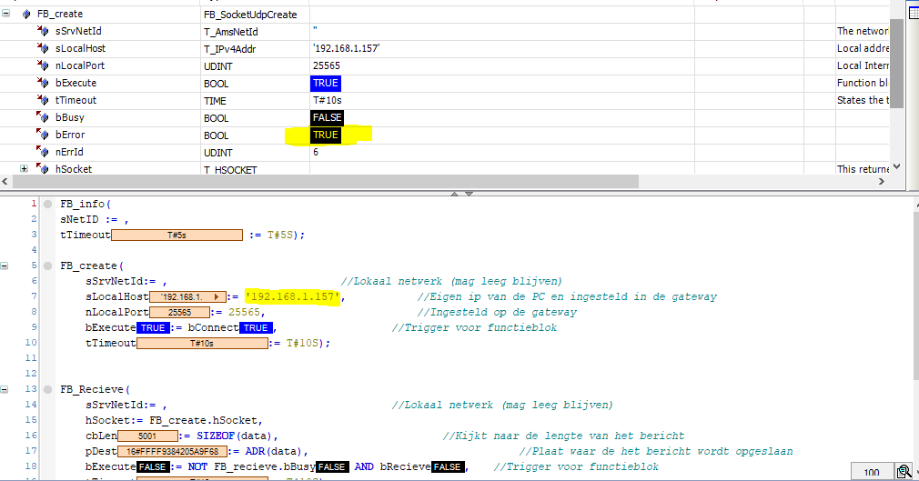
Sigfox
Postman Payload setup
Payload decoding in Twincat
ErrId 6 TwinCat
4

Slide 5
Database
,,,,
5

Slide 6
Einde

